Slide 1
Day 1 Wrap-Up
Microsoft Research
Windows Azure for Research Training
Notes:
The end of day 1 looks the same as the start of day 2. The trainer should tease out of the agenda slides following, what the key learning points are, and contextualize these items for the attendees. There is also an explicit call for questions and dialogue before continuing.

Slide 2
Day 1 recap
Windows Azure Overview
Windows Azure Websites
Windows Azure VMs
Windows Azure Storage
Windows Azure Cloud Services
Notes:
Slide Objectives:
Introduce the topics that will be covered in this session
VALUE PROP
Speaking Points:
Notes:

Slide 3
Day 2 agenda
Windows Azure – Scenarios and Patterns
Windows Azure – High Performance and Scale-Out Computing
Windows Azure – Data Analytics (2 parts)
Windows Azure – Interactive Devices
Wrap-up and summary
Way forward and next steps
Notes:
Slide Objectives:
Introduce the topics that will be covered in this session
VALUE PROP
Speaking Points:
Notes:

Slide 4
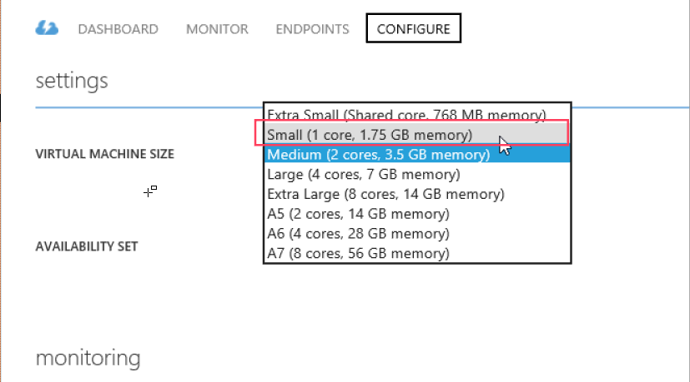
Preparing your VMs for tomorrow
Turn off Windows VM, Configure Linux VM to use 1 core

Slide 5
Questions?

Slide 6
© 2013 Microsoft Corporation. All rights reserved. Microsoft, Windows, Windows Vista and other product names are or may be registered trademarks and/or trademarks in the U.S. and/or other countries.
The information herein is for informational purposes only and represents the current view of Microsoft Corporation as of the date of this presentation. Because Microsoft must respond to changing market conditions, it should not be interpreted to be a commitment on the part of Microsoft, and Microsoft cannot guarantee the accuracy of any information provided after the date of this presentation. MICROSOFT MAKES NO WARRANTIES, EXPRESS, IMPLIED OR STATUTORY, AS TO THE INFORMATION IN THIS PRESENTATION.

